Slide 1
Case Study
CAR 1 – Chris Nicastro Review – Chris Nicastro to discuss
CAR 2 – Julianne Heinzinger Review – Chris Nicastro to discuss
CAR 3 – Gunsimar Paintal Review – Dale Hendricks to discuss
CAR 4 – Dale Hendricks Review – Dale Hendricks to discuss
Team:
Dale Heindricks, Julianne Heinzinger, Chris Nicastro, Gunsimar Paintal

Slide 2
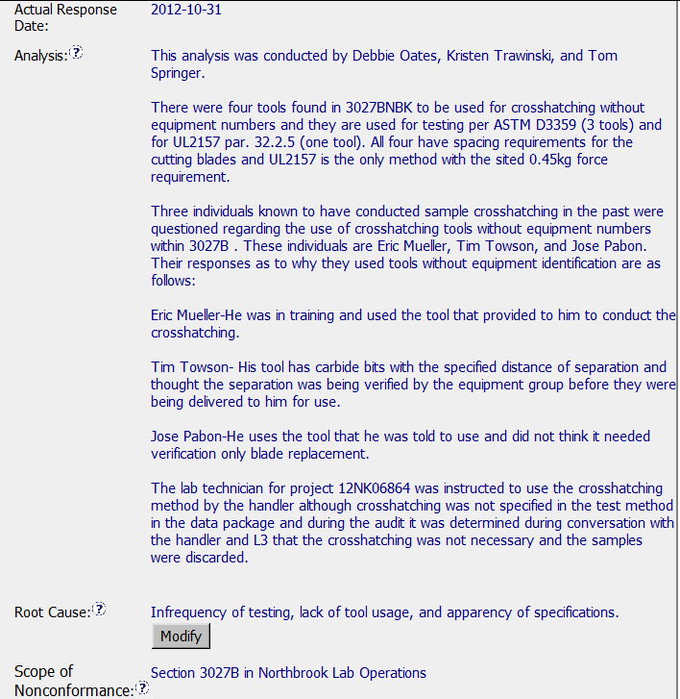
Exemplary CAR – Sample 2 – CAR 123911154
– What corrective actions are expected for this CAR?
Who conducted analysis is included
Clear that these tools were sought out and collected.
Who used the tools in the past was discovered and why they were used. This analysis gets to the real reason these were used, which is what we want in the analysis
Response Details
Root Cause is taken directly from the analysis. It is clear and concise.
Clear how big of issue exists.

Slide 3
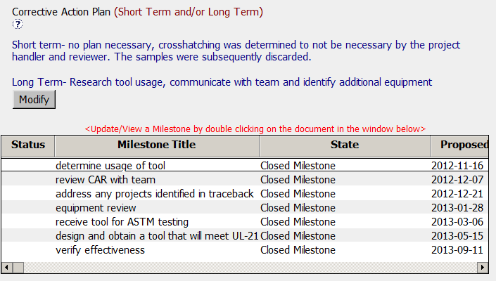
Exemplary CAR – Corrective Action Milestones
The milestones are each a separate event.
This is often preferable to trying to have one milestone cover too much.
As separate events, it keeps it precise as to what is to be accomplished in each milestone.
Containment Addressed
Corrective Action & Milestones
Milestones are all appropriate, they cover how the tool was used, a review with the team to explain the CAR and obtain input and suggestions, determine if a traceback is required, etc.

Slide 4
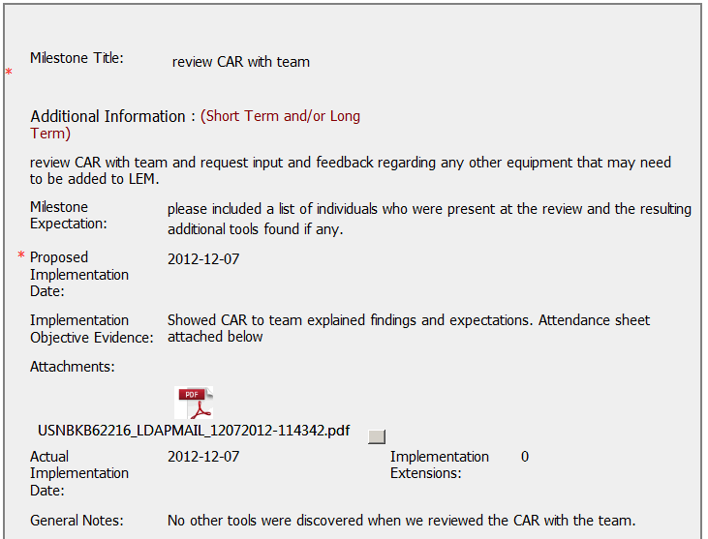
Exemplary CAR – Milestones in Action
This milestone is part of the containment exercise because they need to find out if there are any other tools.
The CAR was reviewed so the team could understand equipment requirements.
An attendance sheet is provided.
Select Milestones

Slide 5
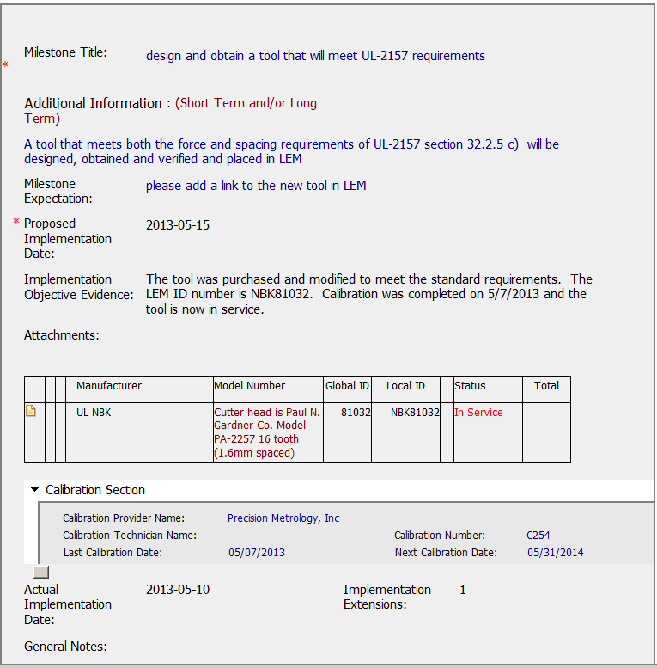
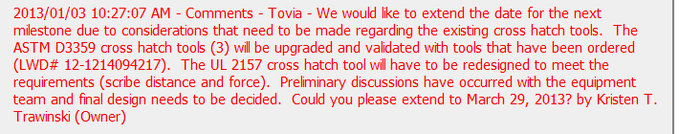
Exemplary CAR – Milestones in Action
This milestone includes evidence that the proper tool was obtained and added into the LEM system.
By ensuring it is in the LEM system, it will be included in calibration.
Select Milestones
Request for extension appropriate. Shows action has been taken and legitimately why more time is required.

Slide 6
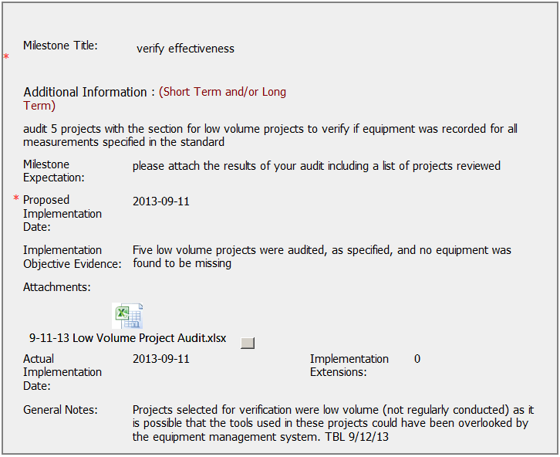
Exemplary CAR – Verification Milestone
Important milestone because this is where the owner can see if the actions implemented were effective.
A spreadsheet is attached which provides a list of projects and shows the verification was conducted.
Owner Verification
CAR Admin provided additional information for clarification

Slide 7
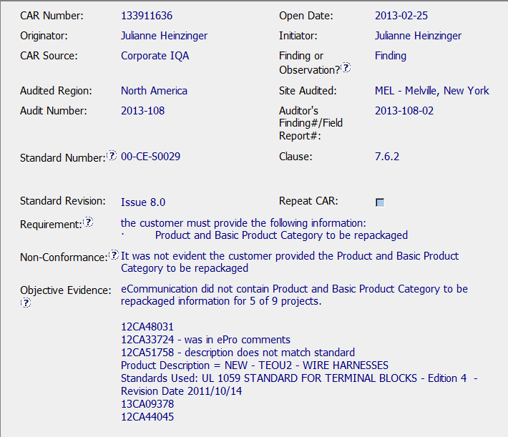
CAR – Sample 3
CAR Number: 133911636
Key elements of the CAR process complied with by correct references to the SOP, Issue no., clause etc.
2. Objective evidence has the necessary detail with Projects reviewed.

Slide 8
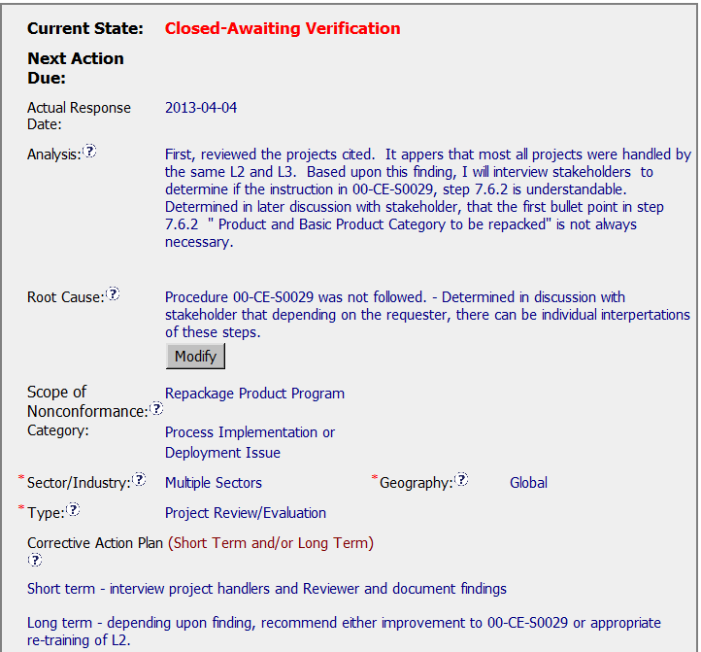
CAR Sample 3
CAR Number 133911636
ANALYSIS
a part of the Analysis is actually in the Containment milestone. If the analysis would have captured this exercise to determine the benefit to revise if any and/or how many open projects are in fact in ePro, the Containment step would not have been necessary with a note “Containment not required since no open projects or only one open project and in compliance”. This being a part of the scope analysis.
ROOT CAUSE
Is too long, the 2nd sentence is really part of the analysis

Slide 9
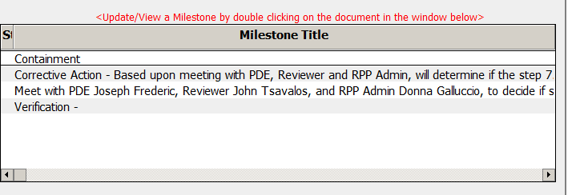

CAR – Sample 3
CAR Number: 133911636
Milestone Titles ( for milestone 2 & 3) should be short and all additional information captured in the section on Additional Information.
Milestones have a lot of information, overall a good thing but at times one gets lost in the weeds.
Overall, this being the RPP program, given what was accomplished was the best under the circumstances.

Slide 10

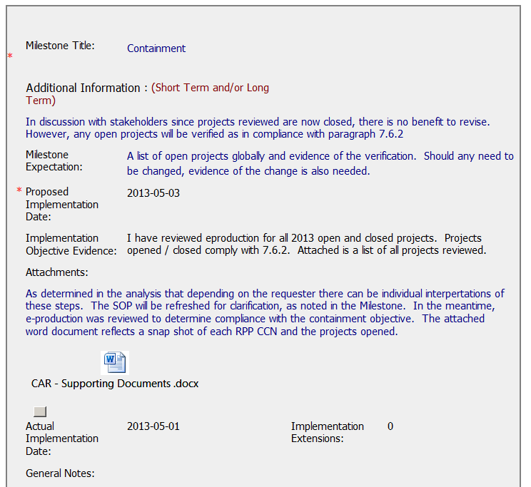
CAR – Sample 3
CAR Number: 133911636
Milestone 1: Containment
Created on April 4, 2013 and implementation objective evidence added on May 1, 2013.
It appears this was an afterthought and added after the “Milestone 2 on Corrective Action” since the CAR document history does not track comments to this effect. May have been verbal or via e-mail between the CAR Owner & CAR Admin.

Slide 11

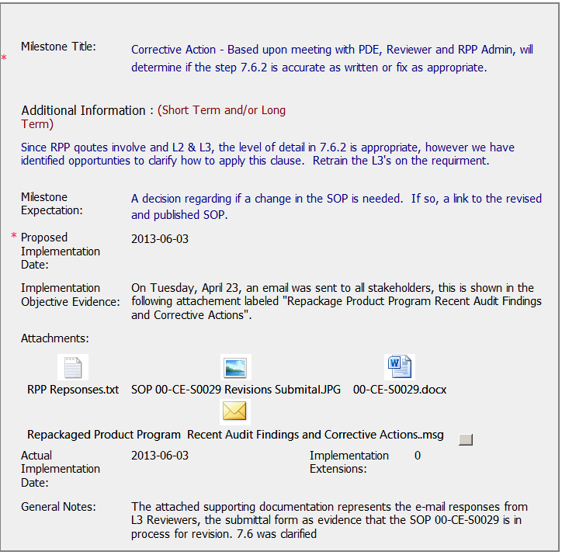
CAR – Sample 3
CAR Number: 133911636
Milestone 2: Corrective Action - Based upon meeting with PDE…
Created on March 25, 2013 and implementation objective evidence added on May 1, 2013.
Milestone expectation - A decision regarding if a change in the SOP is needed. If so, a link to the revised and published SOP.
Milestone accepted on June 11, 2013 while the SOP Approval Status was “pending”. This milestone should have been accepted only once the link to the revised and published SOP was available. The actual date of publication of the SOP was July 12, 2013, one month after the milestone was approved and closed.

Slide 12
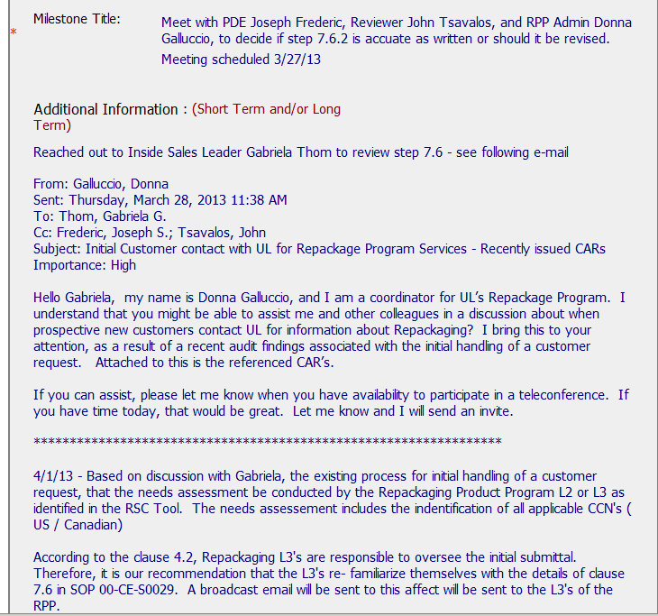
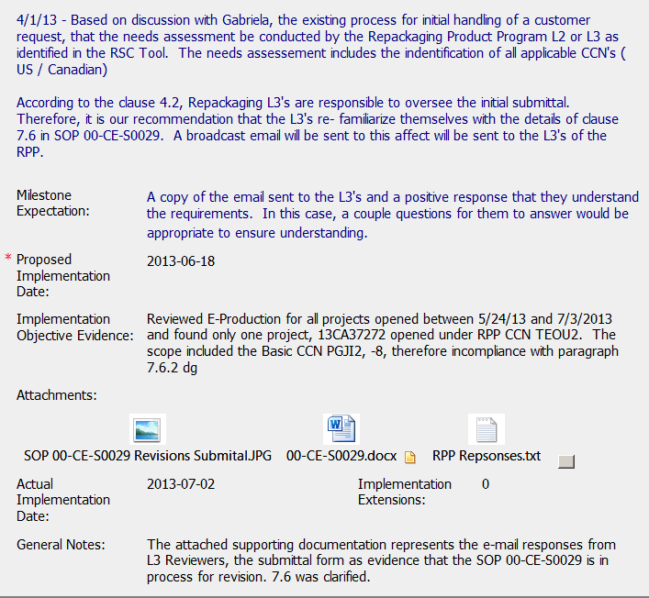
CAR – Sample 3
CAR Number: 133911636
Milestone 3: Meet with PDE Joseph Frederic…..
Milestone expectation – 2nd sentence “In this case, a couple questions for them to answer would be appropriate to ensure understanding”.
This essentially should be determined by the CAR owner as part of the refresh and/or the requirements in the SOP, be it a couple or more questions. By suggesting a couple, are we giving the impression of a minimum criteria to the CAR owner based on which the milestone will be accepted as implemented.
Evidence of Projects between May 24, 2013 to July 3, 2013 not provided in the milestone. There apparently was only one project 13CA37272, however, a listing of all projects that were checked should have been attached as evidence of the effort as well as showing the date range selected.

Slide 13

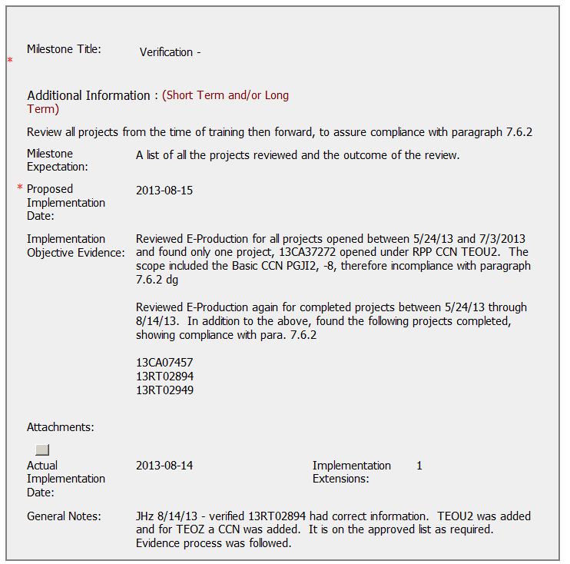
CAR – Sample 3
CAR Number: 133911636
Milestone 4: Verification
Milestone expectation – A list of all the projects reviewed and the outcome of the review.
The expectation should be specific. Here as a suggestion, rather than state all projects, better would have been to state a date range or an ‘x’ no. of projects. Knowing that RPP has a limited scope and no. of CCN’s, as such we do not expect a large no. of projects. However, there needs to be a reasonable no. / length of time to determine effectiveness of the corrective actions.

Slide 14

CAR Review
Sept 27, 2013
Mark Lavine, Mel Fehrenbacher

Slide 15
CAR 133911636
Good sample size in finding
Good use of attachments
Analysis good, but could have been more robust, for example, if the Product and Basic Product Category, is not always needed, why was this not mentioned in the SOP?
Containment and verification included
Action taken to prevent recurrence- procedure changes- good.
Good collaboration between PDE and CAS

